Slide 1
Week 10 Updates Shapiro
By Evan Johns

Slide 2
Athena Supplemental Figure Analysis
Misaligned figures likely responsible for a large portion of the error that we are observing.
TMA Core C has much stronger correlations between the protein and mRNA data than TMA Core A. Likely because TMA Core C has better alignment.

Slide 3
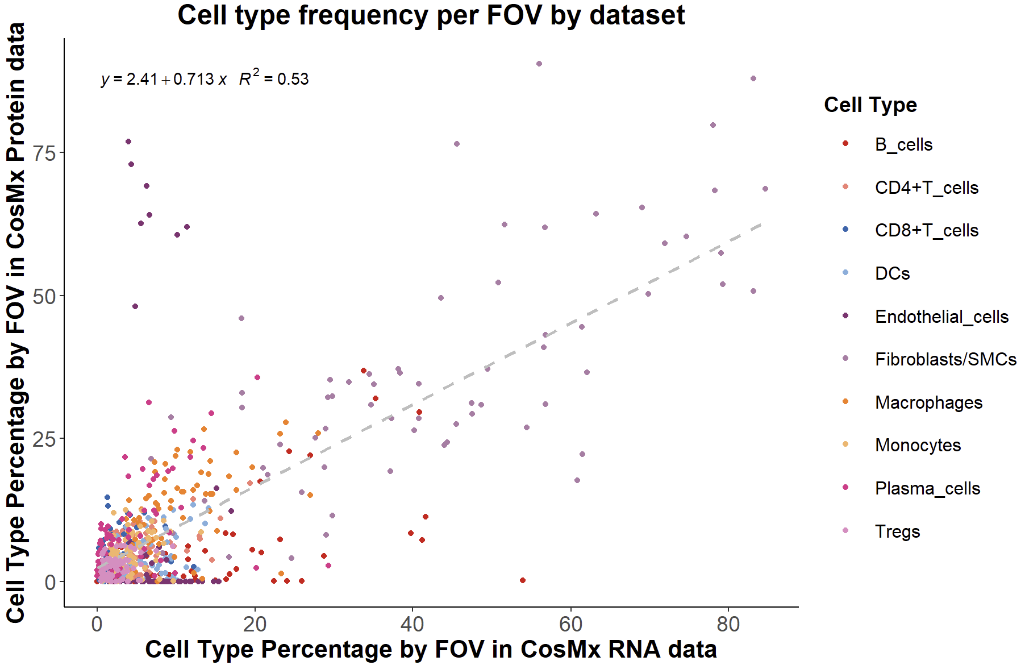
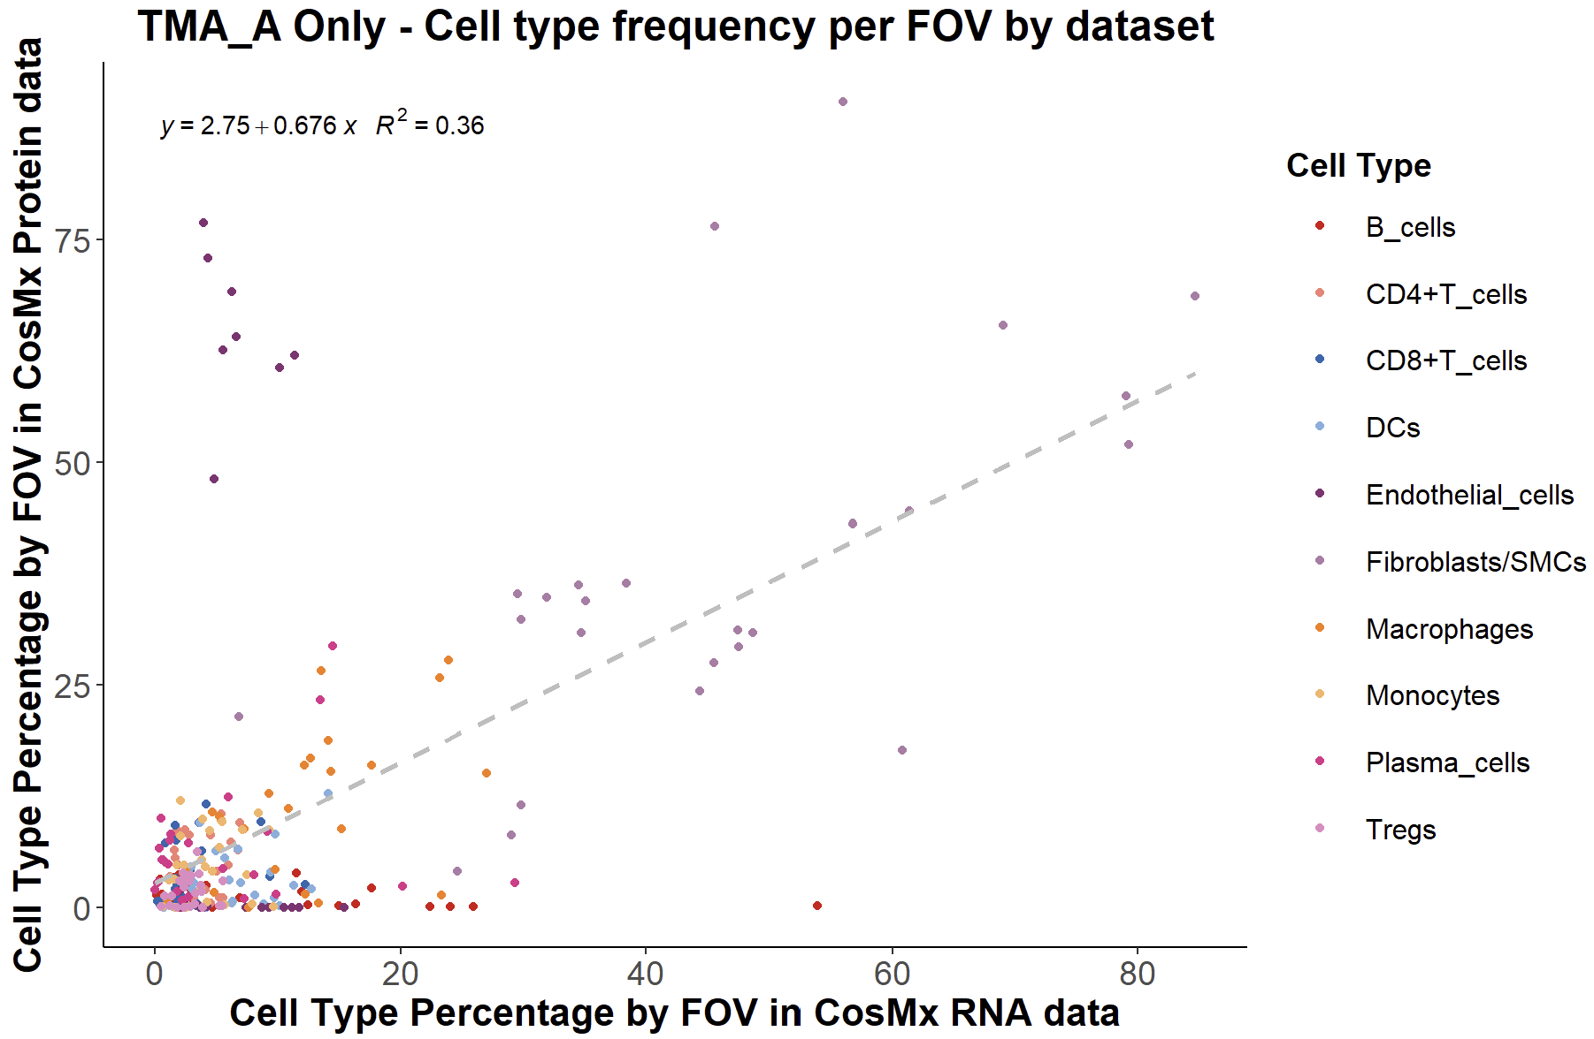
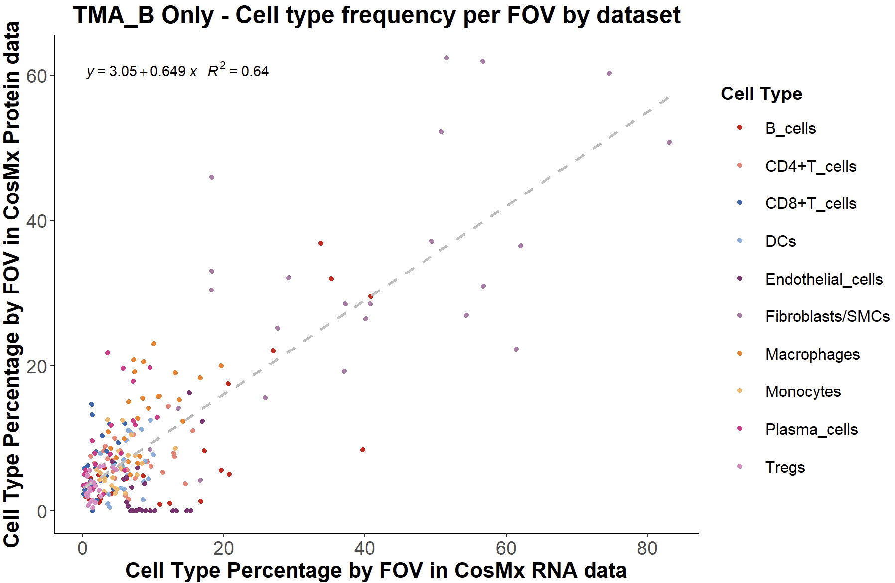
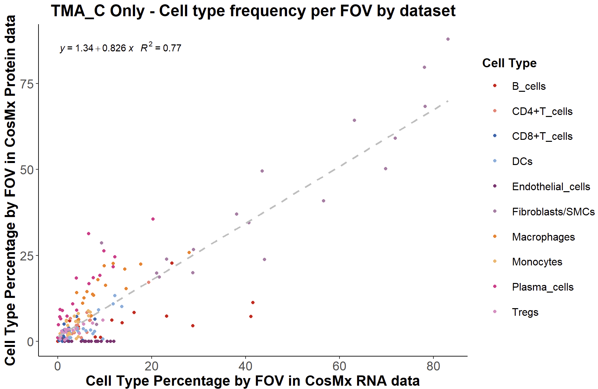
Supplemental Figure Analysis

Slide 4
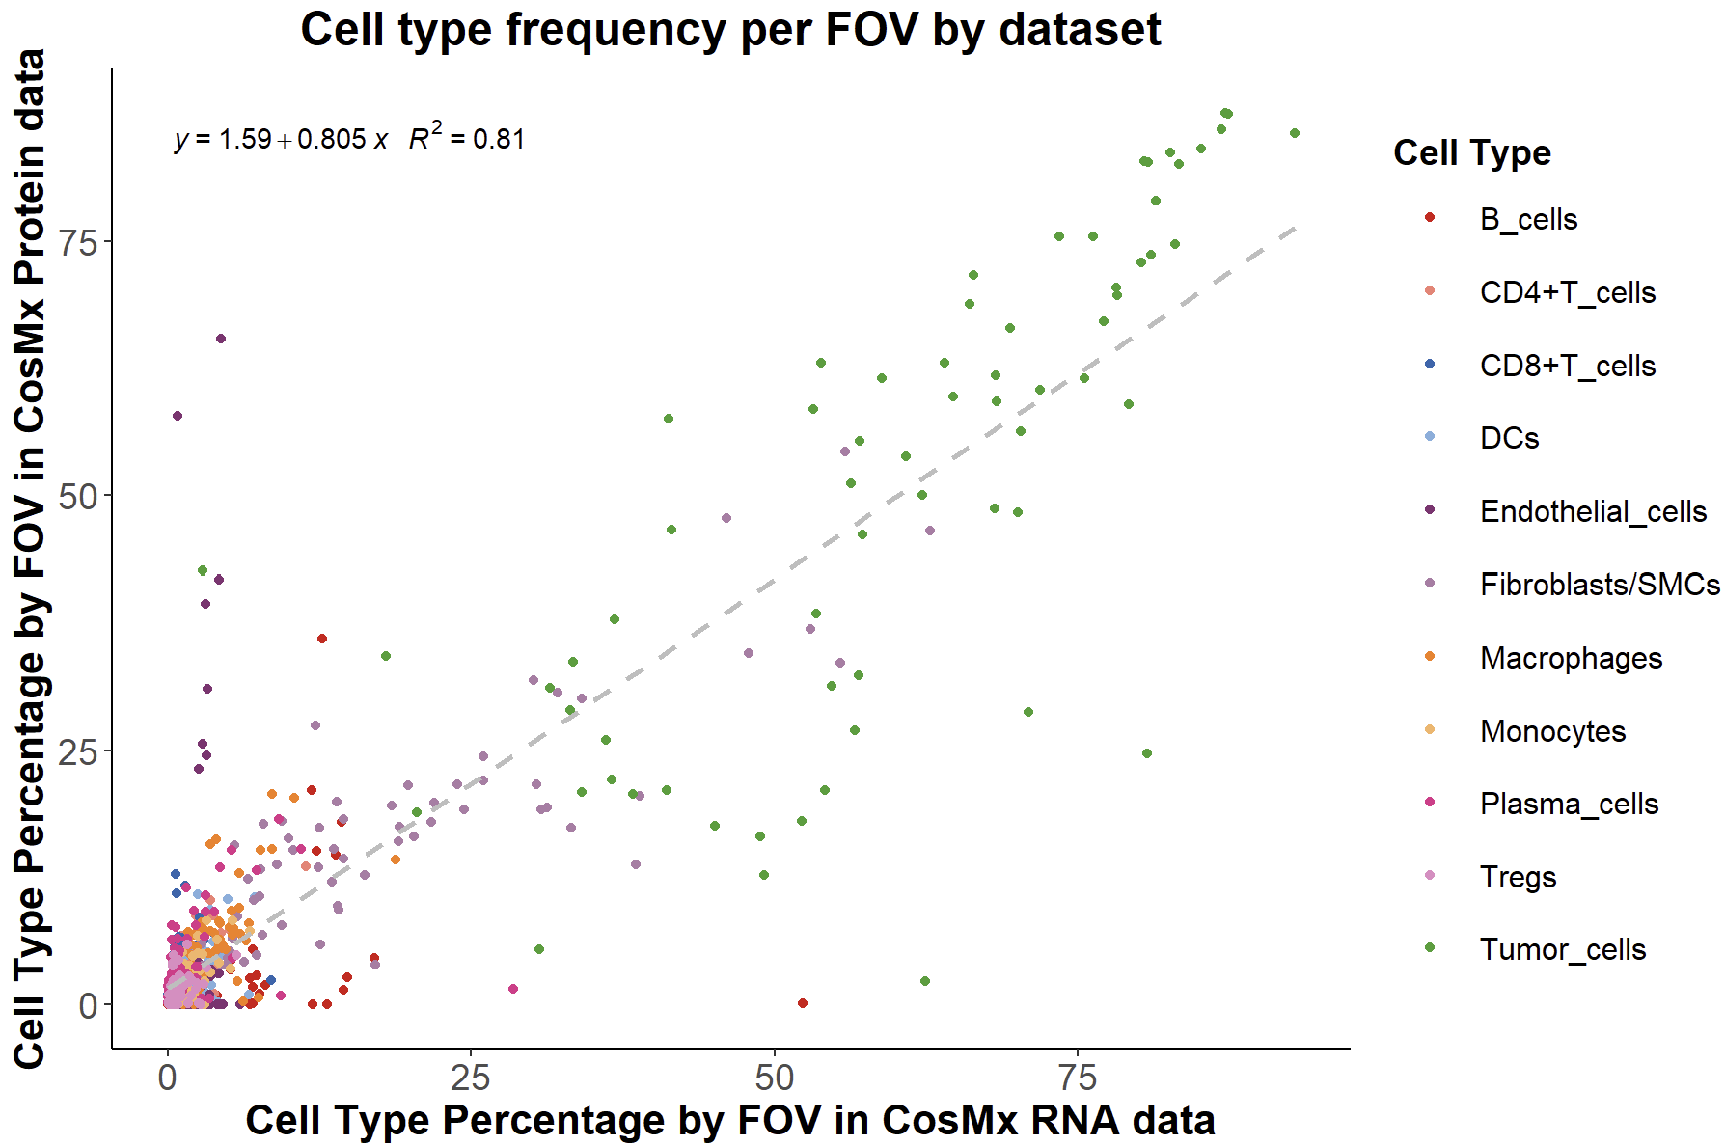
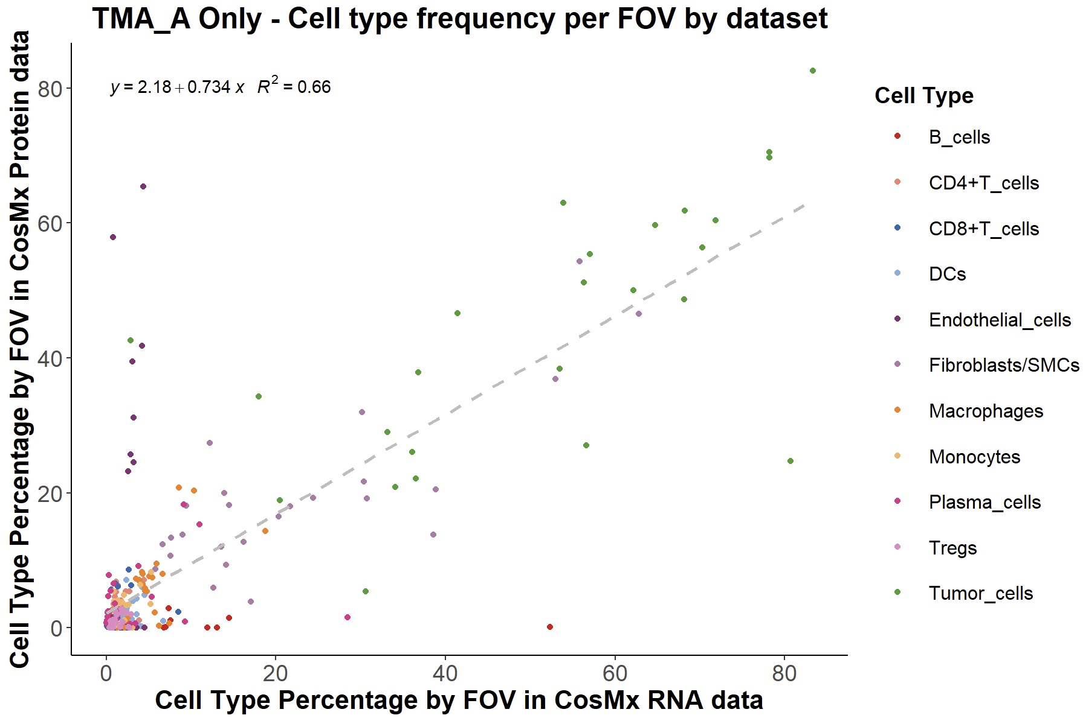
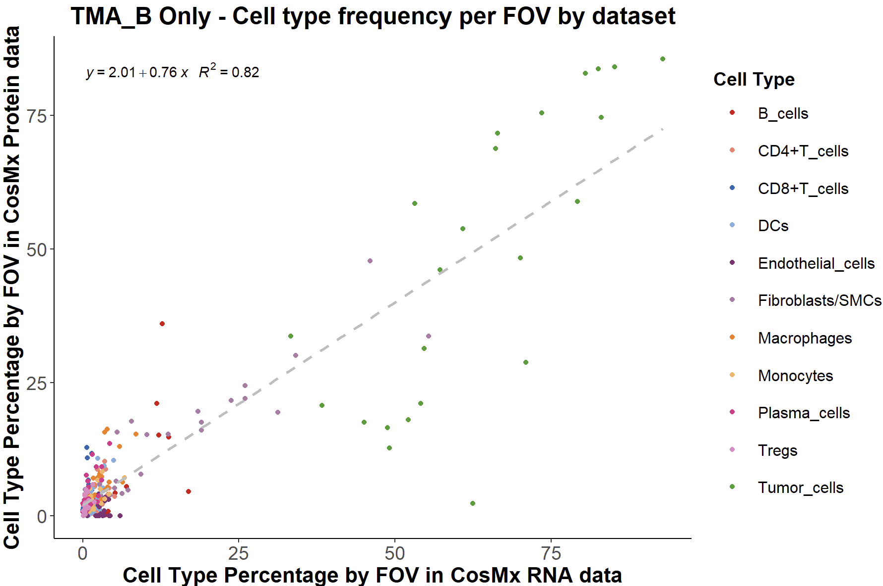
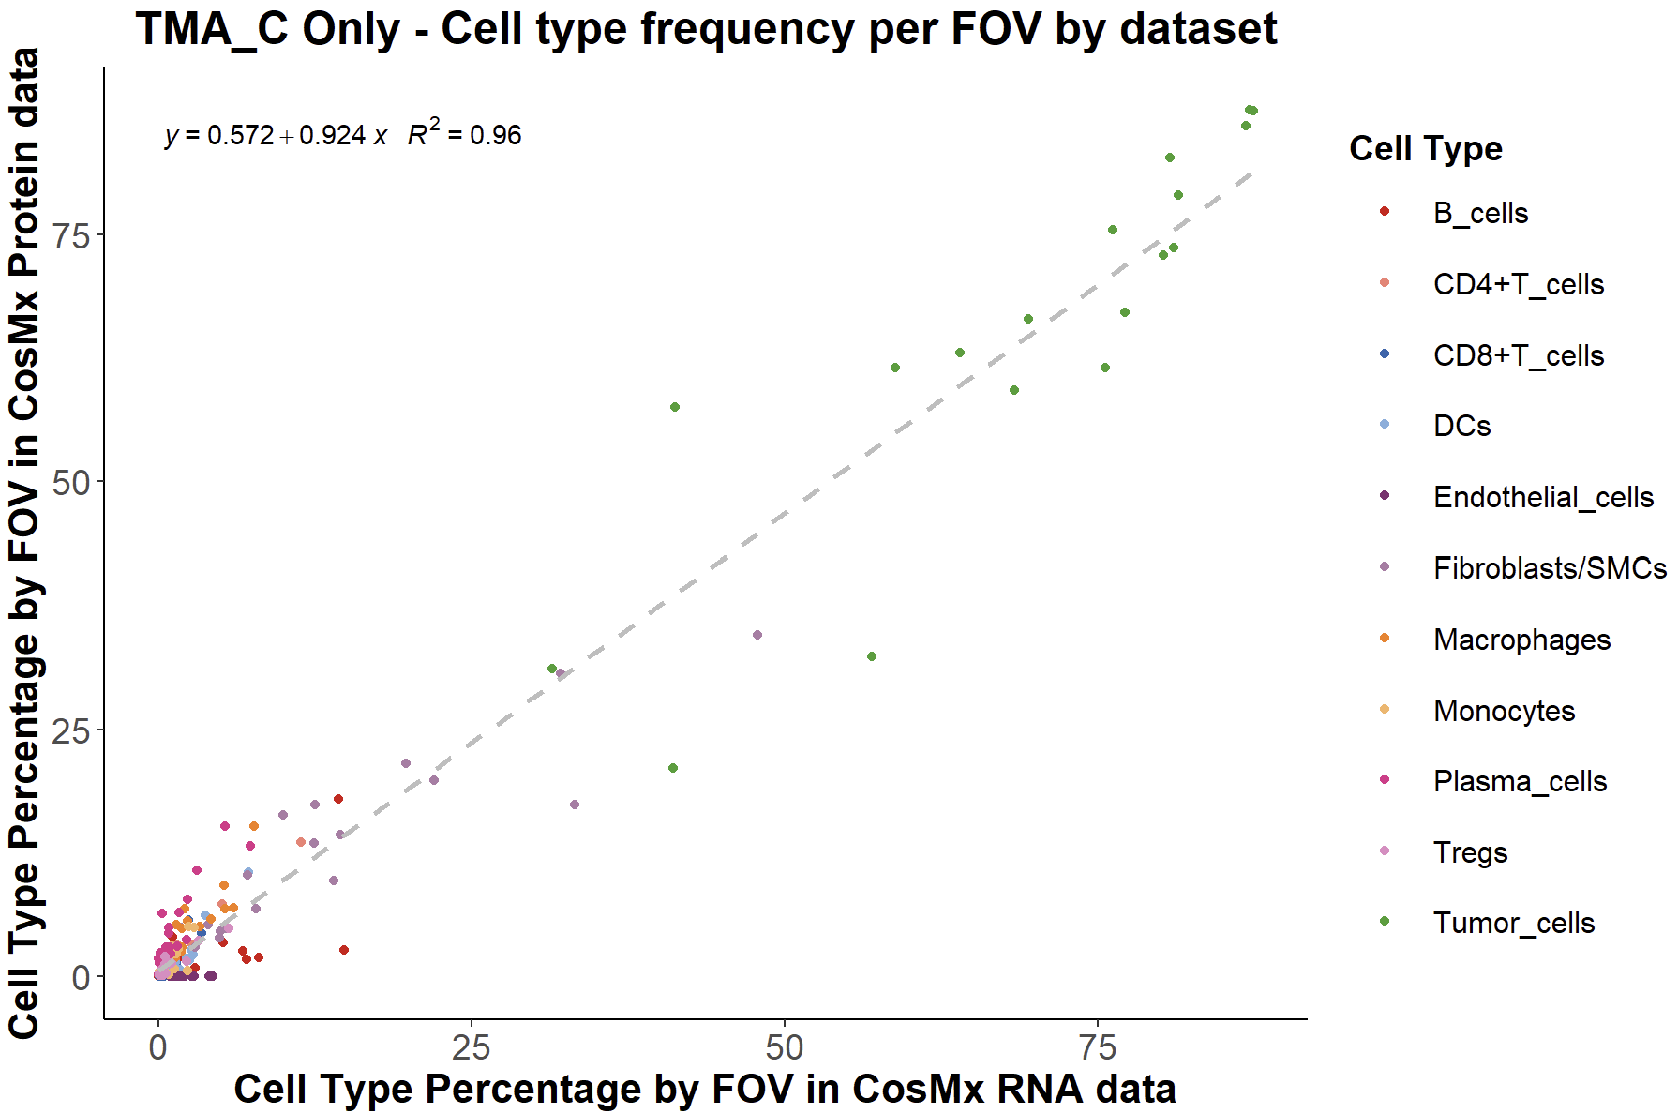
Supplemental Figure Analysis

Slide 5
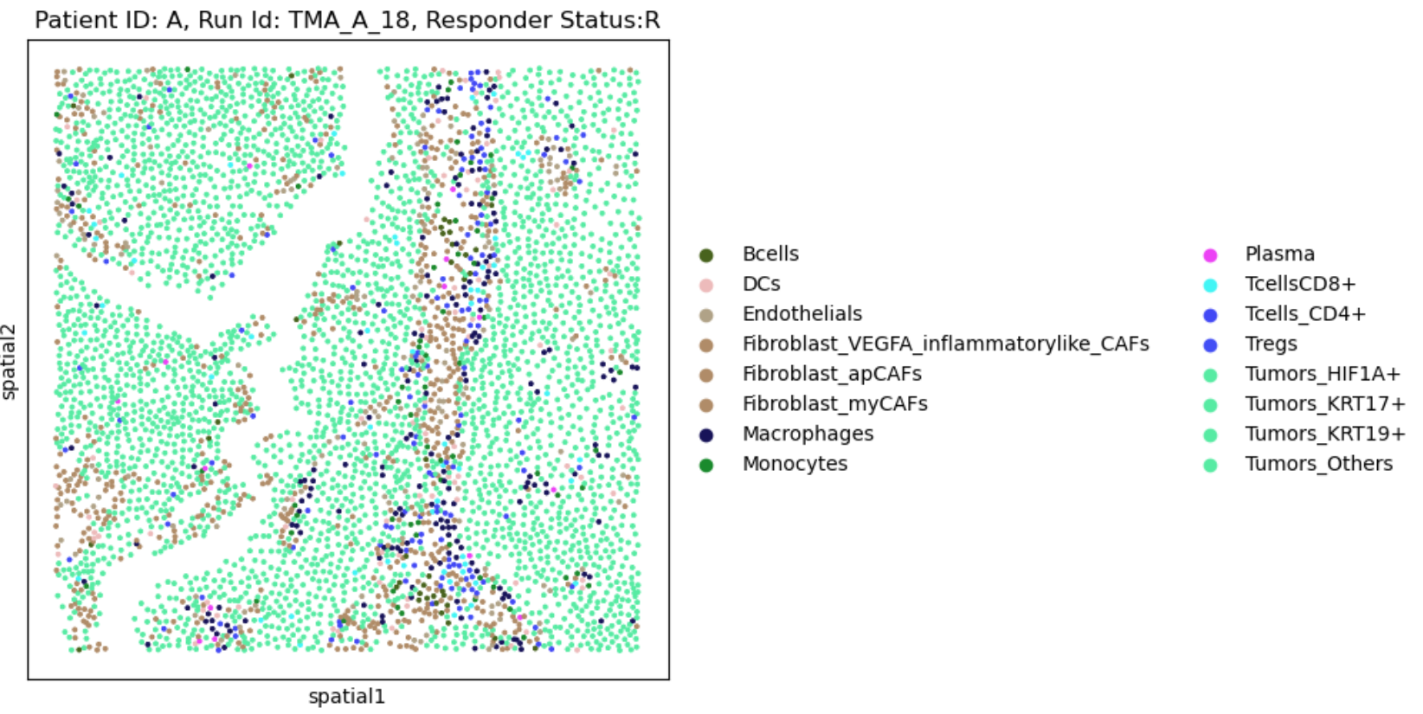
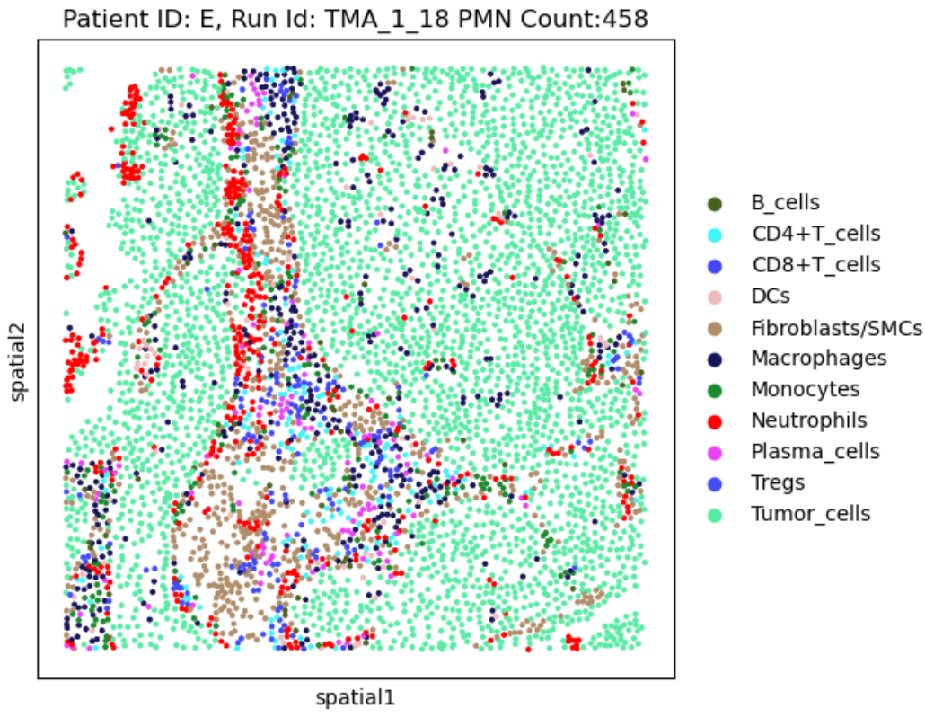
Comparing Suspect PMN cells to rest of the sample
mRNA
Protein

Slide 6
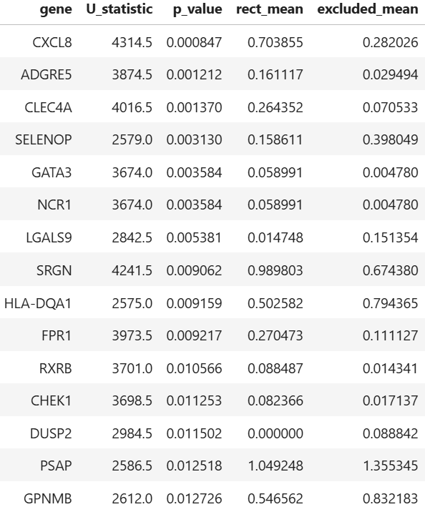
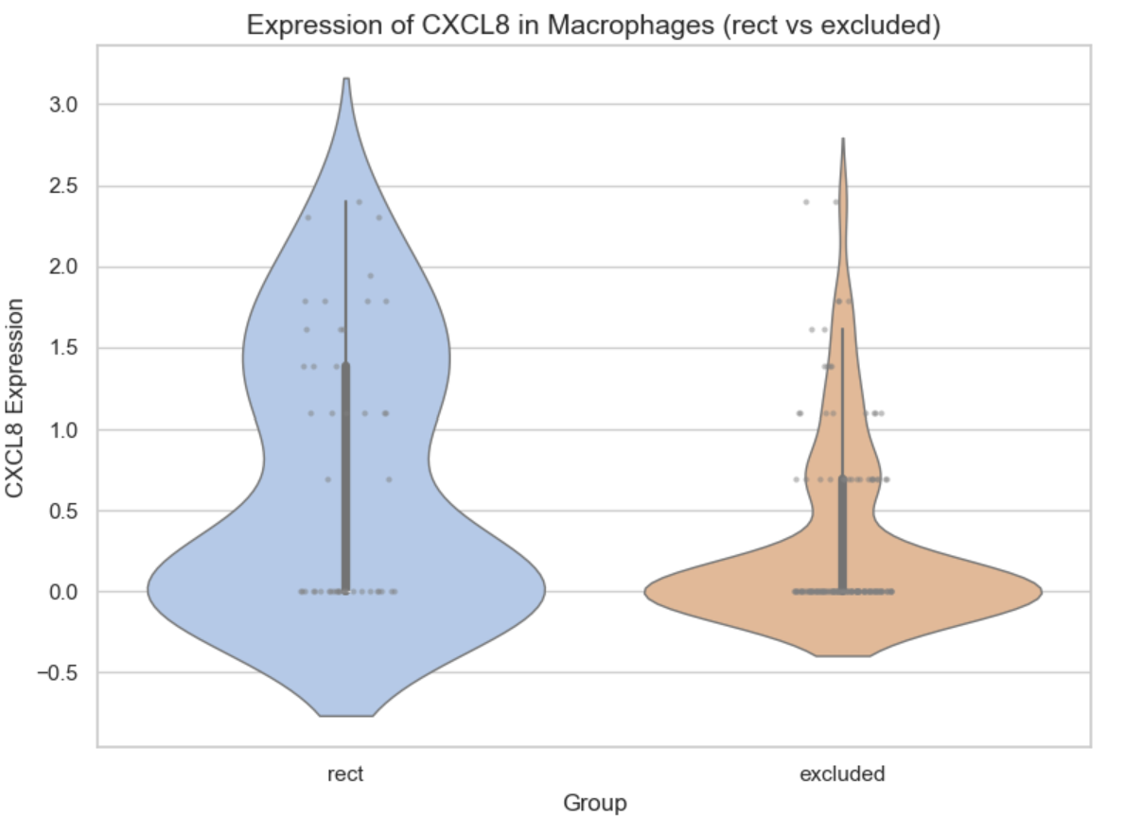
Statical Differences
Compared suspected neutrophils (macrophages in red box) to macrophages outside of the red box.
Lots of noise. Cells even of the same type have high expression differences.

Slide 7
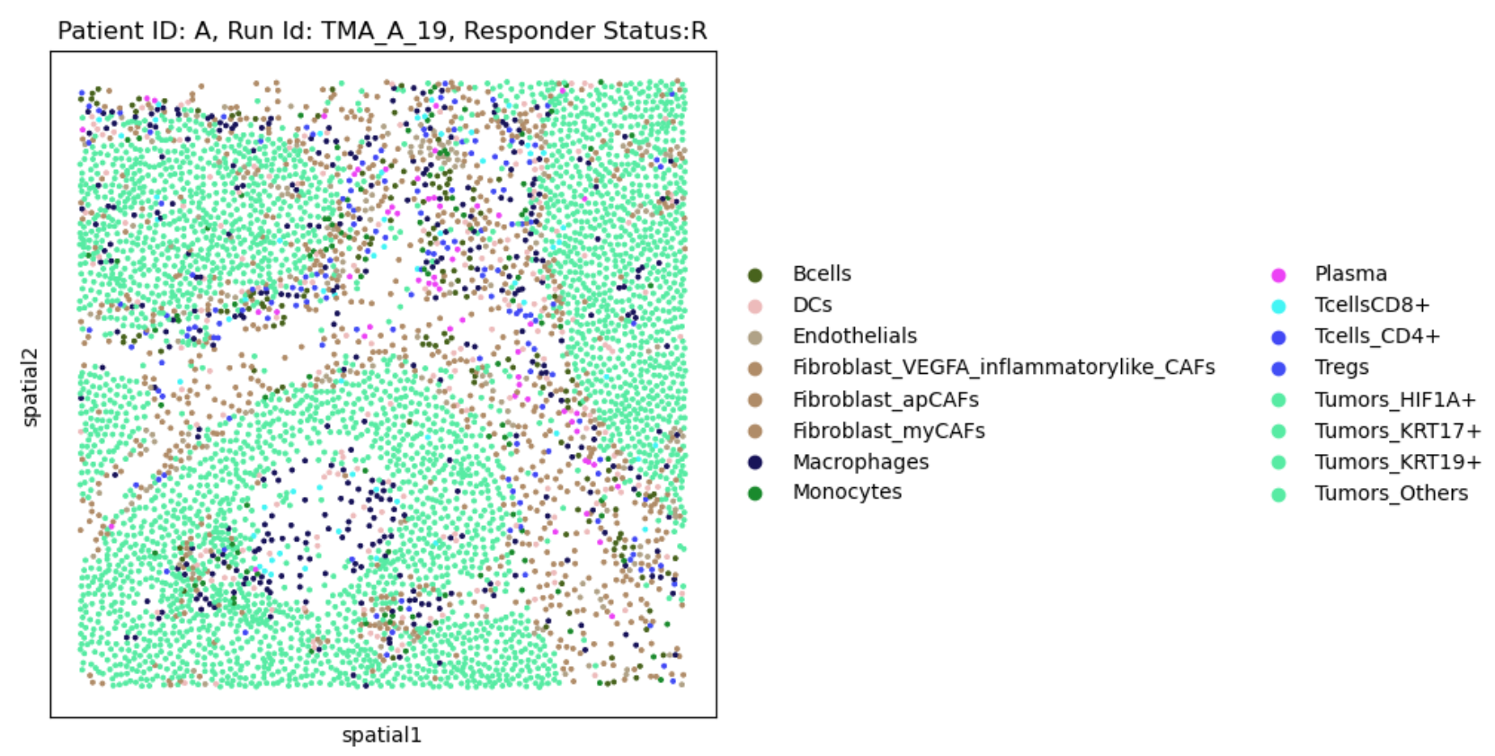
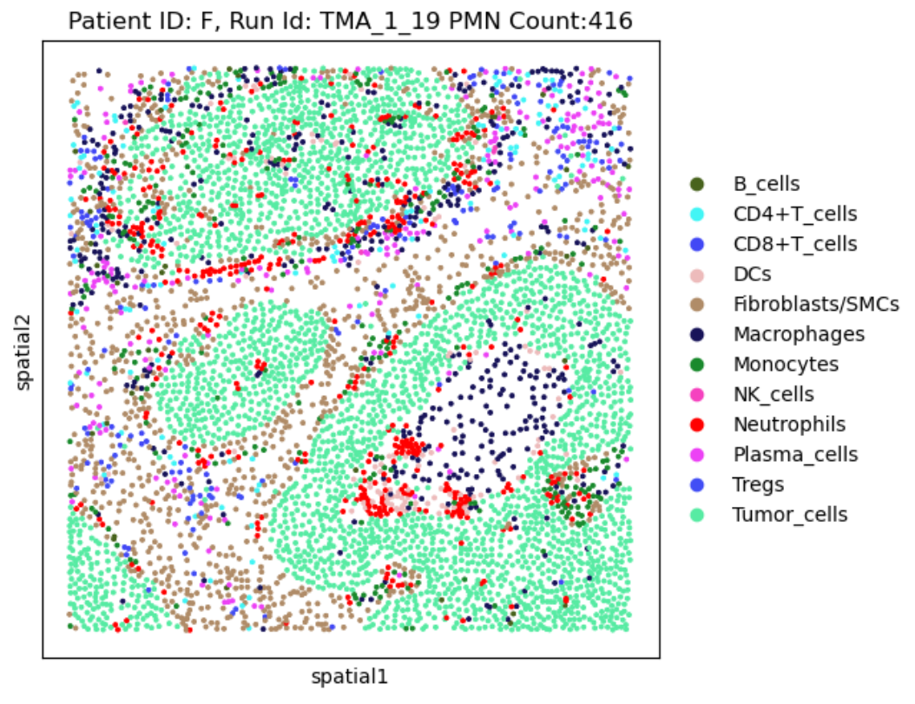
mRNA & protein comparison
mRNA
Protein

Slide 8
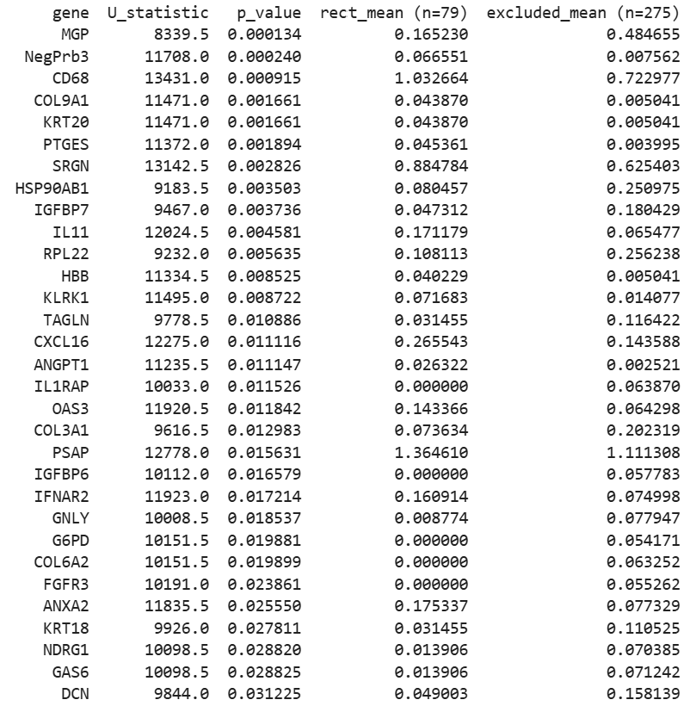
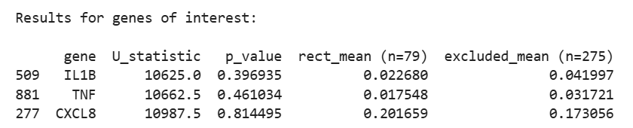
Statical Differences
Compared suspected neutrophils (macrophages in red box) to macrophages outside of the red box.

Slide 9
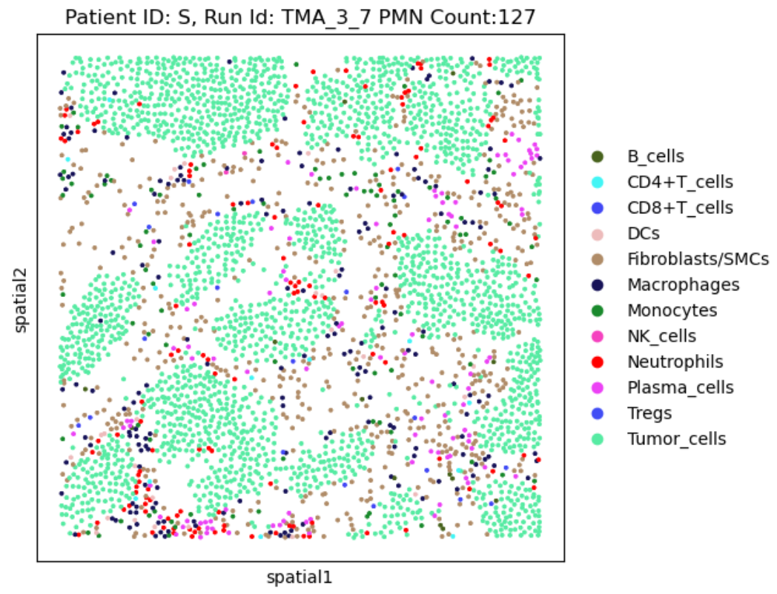
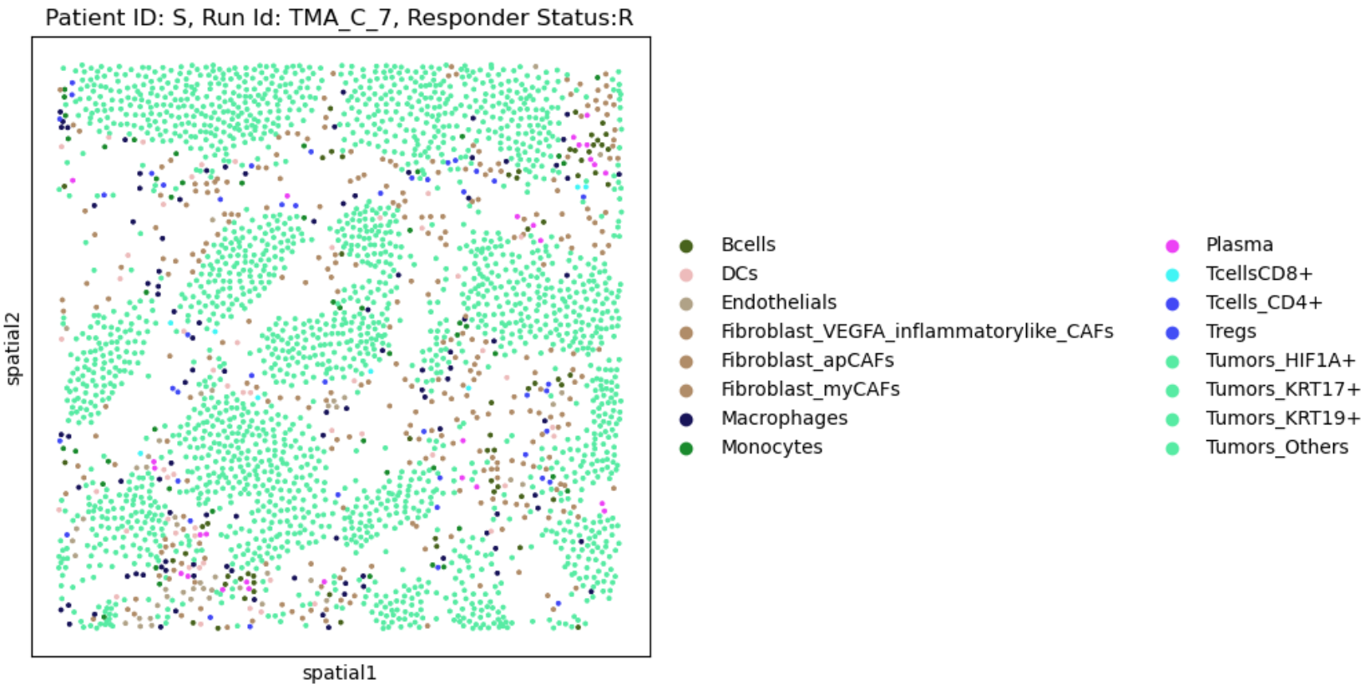
mRNA & protein comparison
mRNA
Protein

Slide 10
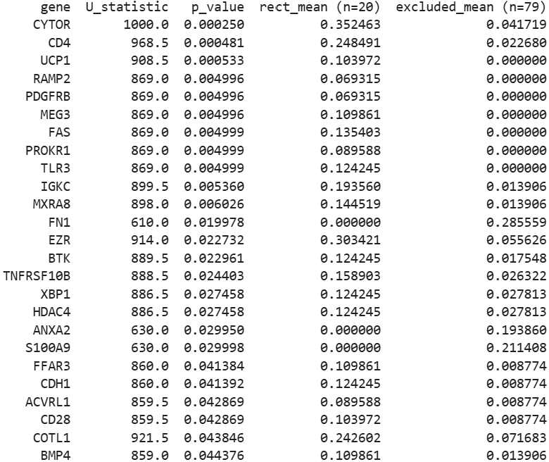
Statical Differences
Compared suspected neutrophils (macrophages in red box) to macrophages outside of the red box.

Slide 11
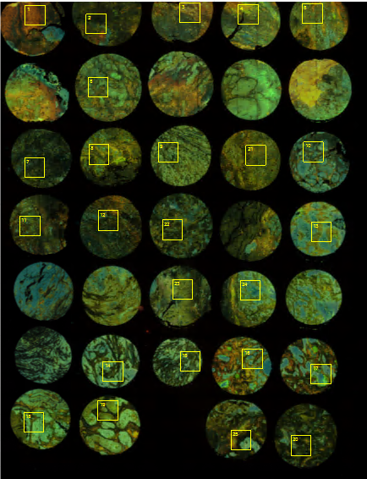
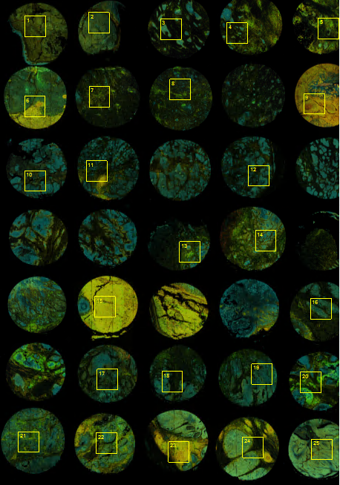
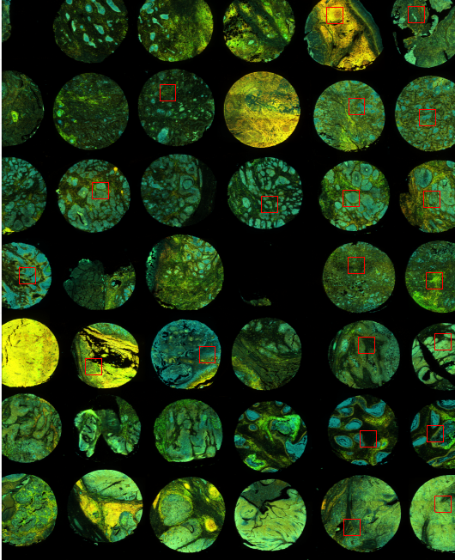
TMA CORE ALIGNMENT Protein
protein TMAA
protein TMAB
protein TMAC
Text

Slide 12
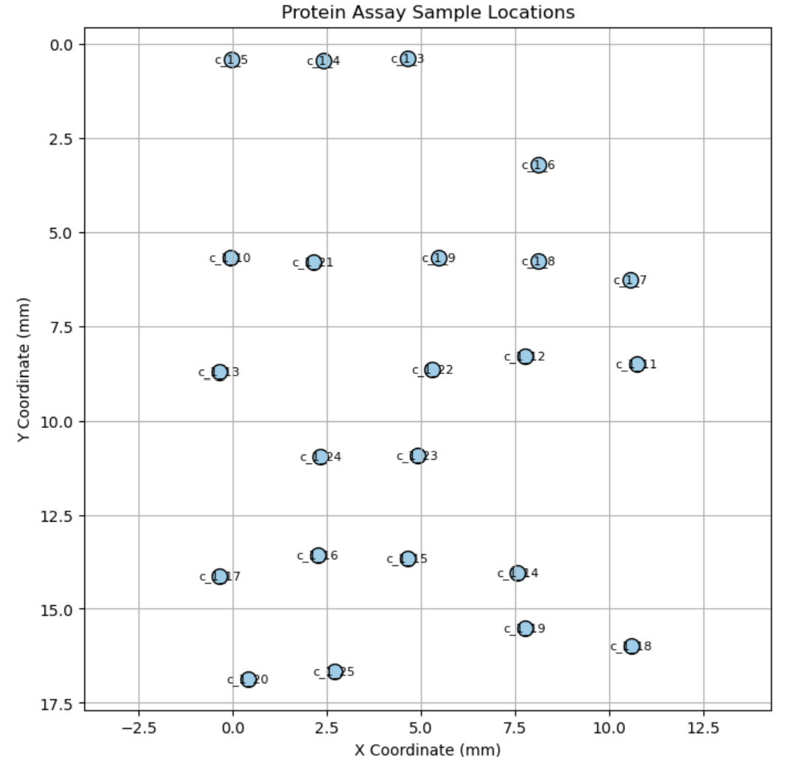
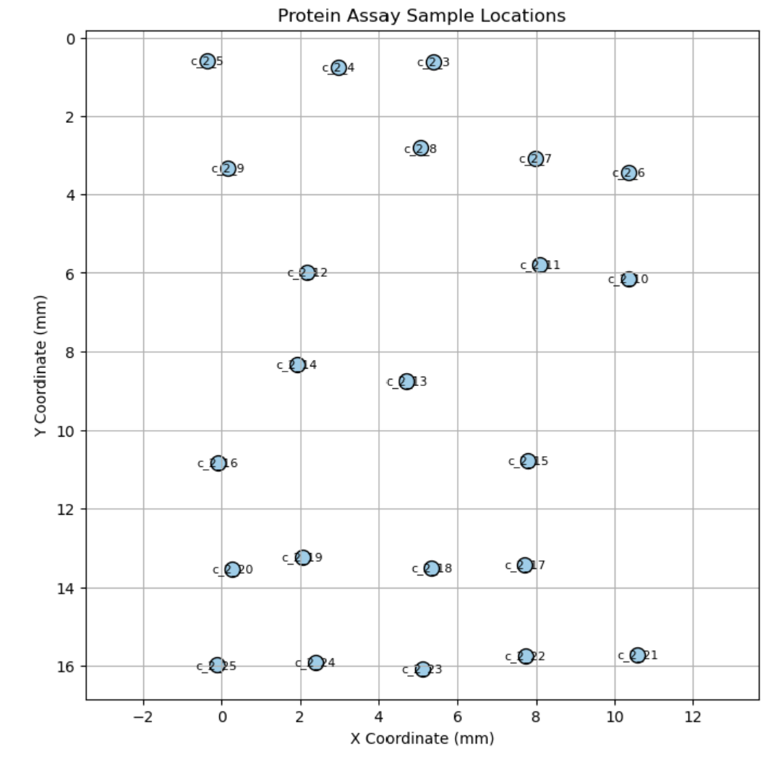
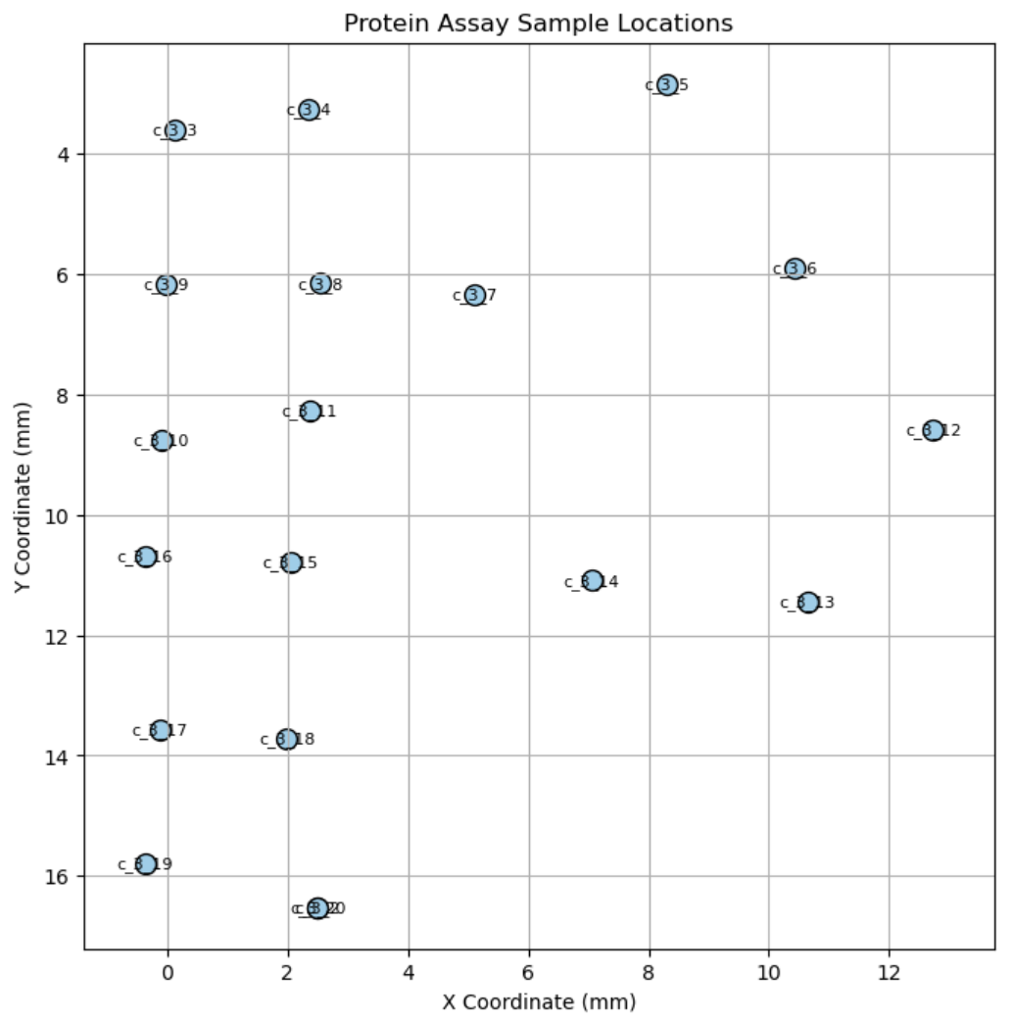
Global Coordinates of Protein Data

Slide 13
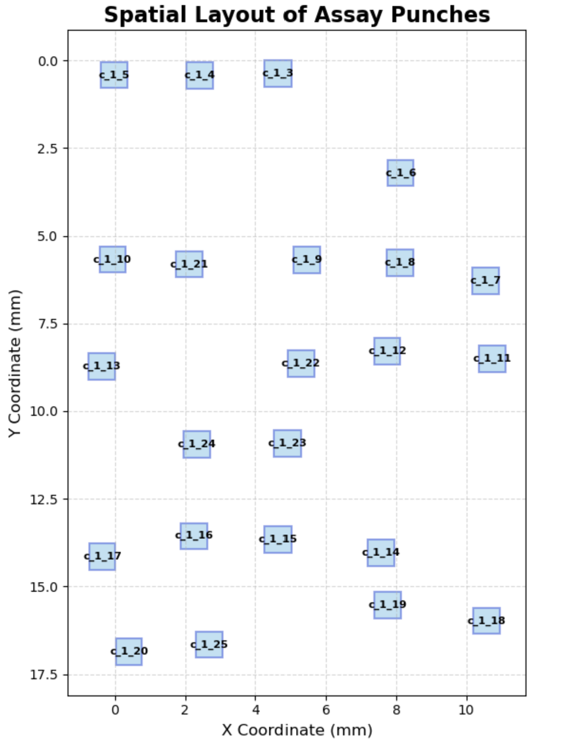
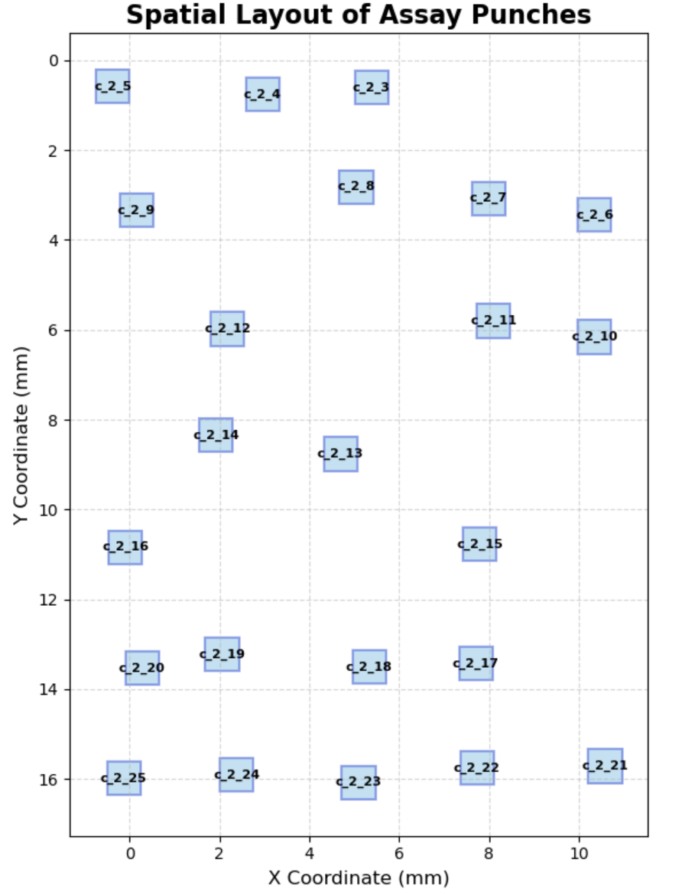
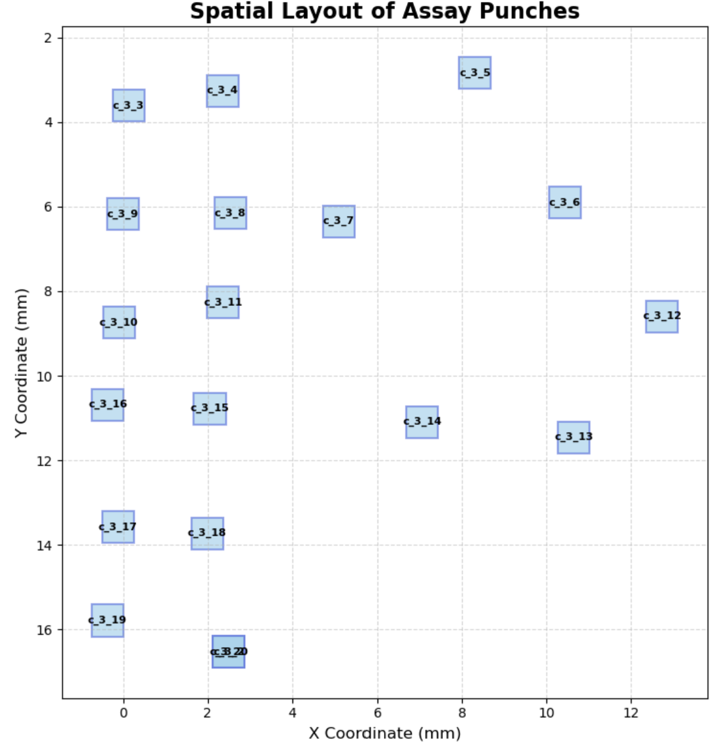
Global Coordinates of Protein Data

